Slide 1
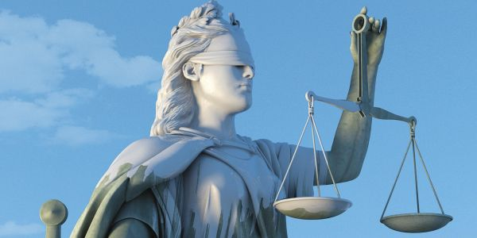
When Life is Unfair
Ecclesiastes 3:16-22
Dr. Rick Griffith • Crossroads International Church Singapore
CICFamily.com • BibleStudyDownloads.org

Slide 2
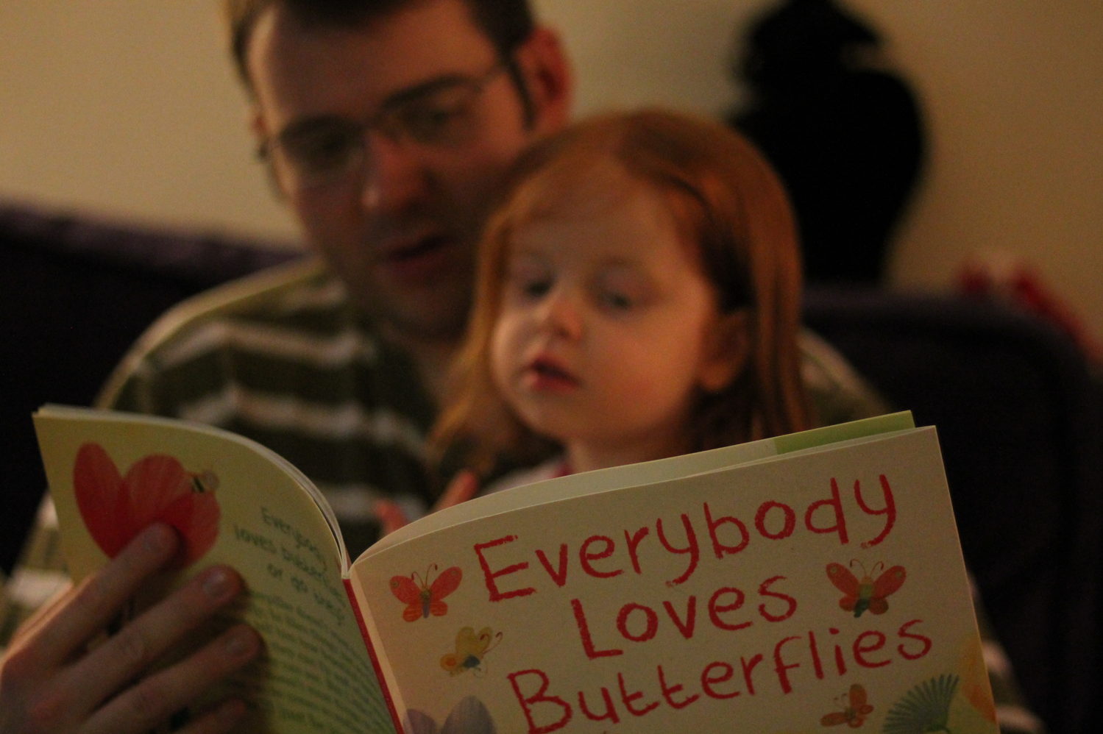
Everybody loves a story.
Notes:
Chuck Swindoll writes, "Everybody loves a story. We especially like stories that have neat and tidy endings. We don't mind if there is sadness and hardship—just so there's justice in the end. We like for right to win and wrong to lose. We want the guys in the white hats to come out on top and the ones in the black hats to wind up in jail. Let me illustrate this from a few well-known fairy tales.

Slide 3
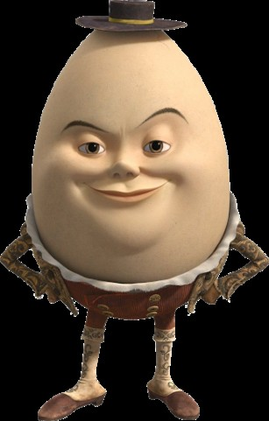
Humpty Dumpty
Humpty Dumpty
sat on a wall,
Humpty Dumpty
had a great fall.
All the king's horses
and all the king's men
Couldn't put Humpty
together again.
Notes:
"Humpty Dumpty: As children we were never bothered by the fact that even though all the king's horses and all the king's men worked feverishly to put Humpty Dumpty back together again, they were unable to do so. Part of the reason we could live with Humpty's situation was the realization that nobody pushed him off that wall. That would've been unfair and unjust treatment.

Slide 4
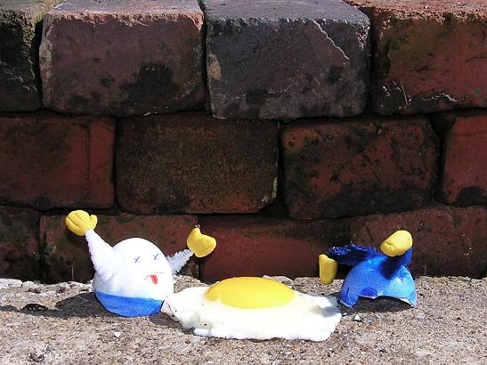
Humpty Dumpty
Humpty Dumpty sat on a wall,
Humpty Dumpty had a great fall.
All the king's horses
and all the king's men
Couldn't put Humpty together again.
Notes:
Eggs have no way to defend themselves. Since nobody was to blame for his condition and since everybody from the king's horses to the king's men tried everything they could to help him out, we can tolerate the sad ending. His story may be unhappy, but it is not unjust.

Slide 5
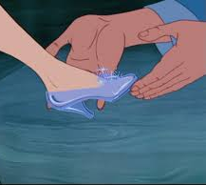
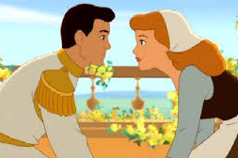
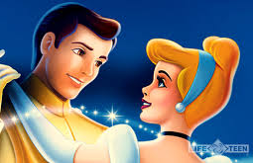
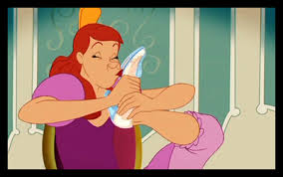
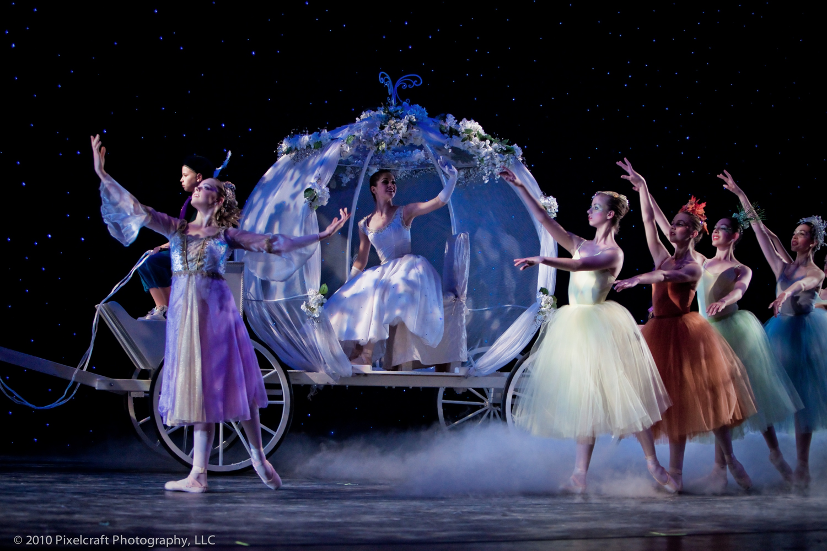
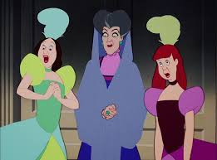
Cinderella
Notes:
"Cinderella: This lovely young woman was raised in a cruel home by a cruel stepmother. Her cruel stepsisters only added to her misery.
/// As you recall, she went to the ball and had a great time, but at midnight the carriage she was traveling in turned into a pumpkin. But that was okay. We can live with that because she was warned about the possibility of that happening. And it's especially okay since, in the end, she got the glass slipper and lived happily ever after. Justice won out.
/// "What we would not have been able to live with is that if somehow one of the cruel stepsisters would have gotten that slipper. That would not have been just. Cinderella's foot deserved the slipper. We smile at such poetic justice."

Slide 6

"Sad endings we can handle, but not unjust ones. Suffering makes us sad, but injustice makes us mad."
(Charles R. Swindoll,
Living on the Ragged Edge, 98)
Notes:
Of course, as adults, we now know that these are only fairy tales. As Swindoll says, "Sad endings we can handle, but not unjust ones. Suffering makes us sad, but injustice makes us mad"

Slide 7
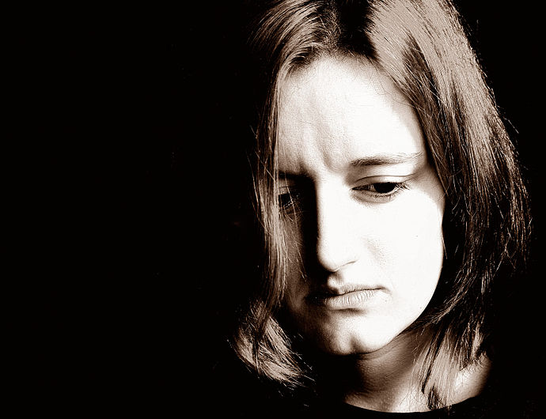
What injustices irk you most?
No credit?
Politicking?
Birth defects?
Cutting in line?
Family background?
Notes:
Injustice comes in many forms.
• Not getting credit is really frowned upon here in Singapore. It just doesn't seem right to work hard and then others get ahead instead. That's not fair.
• Some of us are victims of being left behind in politicking at work where someone's unjust "climbing the corporate ladder" left us out. That's not fair.
• What about birth defects or life-changing accidents? Is it fair that one of my SBC colleagues had three special needs children who are not expected to live to age 25 while I have three healthy sons? That's not fair.
• Sometimes injustice is as simple as others cutting in line.
• Maybe your family background is unjust.
How does injustice make you feel? Angry? Vengeful? Withdrawn?

Slide 8

Cover
Under the Sun
A Study of the Book of Ecclesiastes

Slide 9
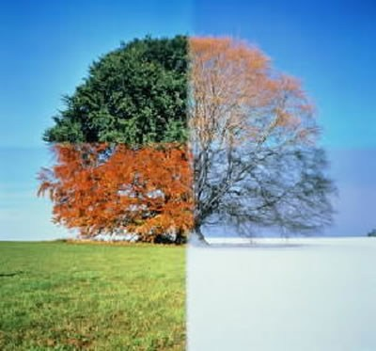
"Yet God has made everything beautiful* for its own time"
(3:11a NLT)
* "appropriate" (NAU), "fitting" (5:18)
Notes:
The Hebrew reads literally "beautiful" but

Slide 10
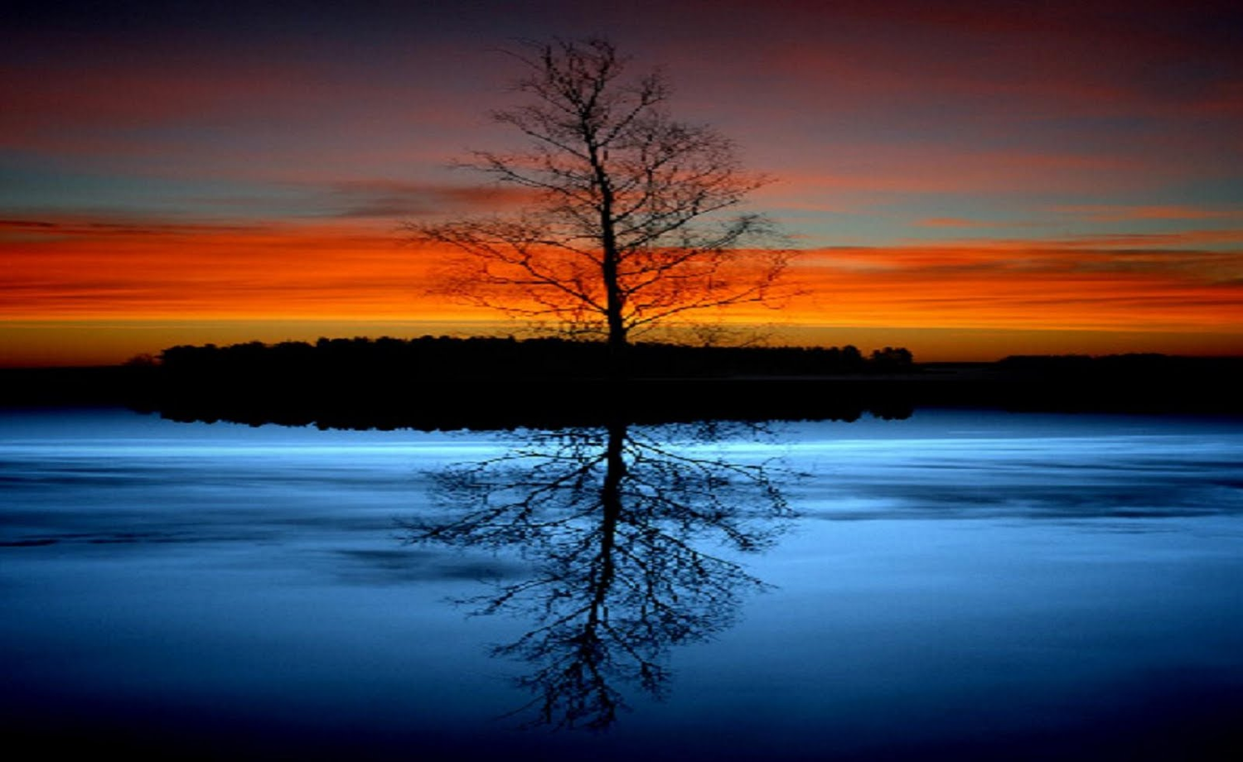
Does God condone injustice?

Slide 11

What should you do when life is unfair?

Slide 12
Issues & Responses
Ecclesiastes 3:16-22

Slide 13
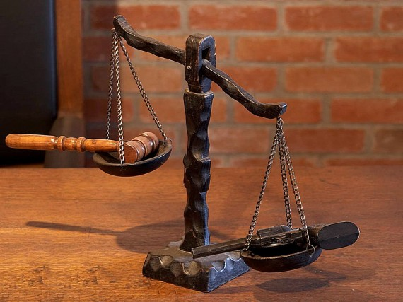
I. Realize that you will account to God (3:16-17).
Injustice
You

Slide 14

Injustice exists in the courts where it shouldn't (3:16).

Slide 15
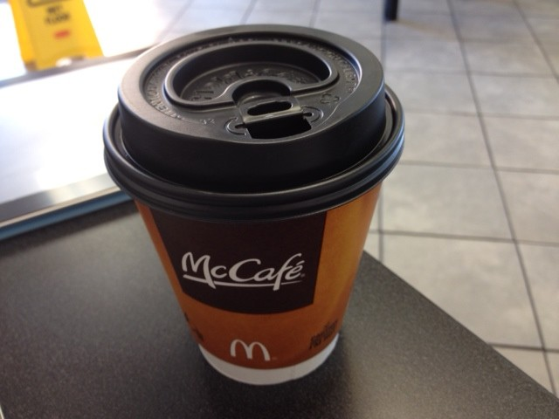
McDonalds Coffee
Notes:
You've probably heard about the guy who sued McDonalds because he spilled his coffee on himself and got burned. The court sided with him as the cup didn't explicitly say that the coffee inside was really hot!

Slide 16
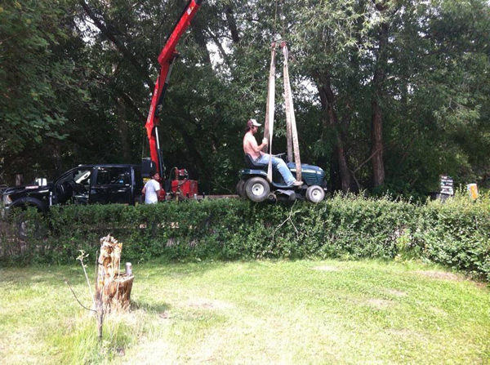
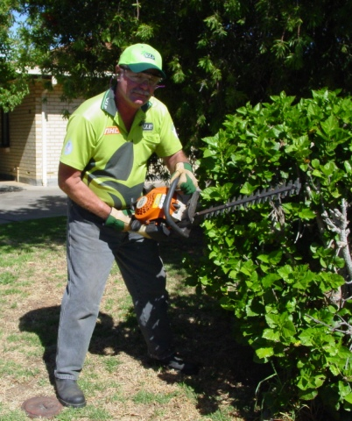
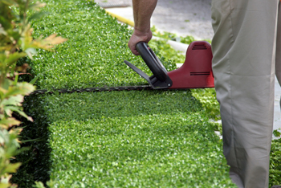
Lawn Mower
Notes:
Another man used a lawn mover to cut his hedge. A normal person trims with a hedge trimmer. Not this guy! He used a lawn mower for his hedge! Of course, the mover got caught on the hedge and cut into his arm. He was awarded $167,000 because the judge ruled that the instructions should have warned against using it as a hedge trimmer! For crying out loud, it's called a lawn mower!

Slide 17
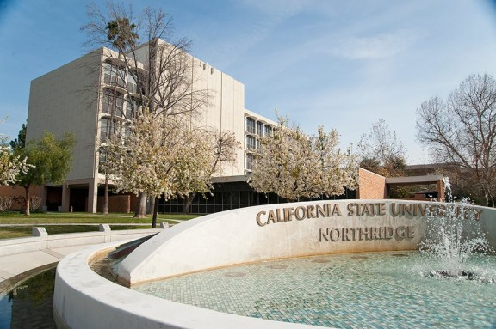
Young Earth Lawsuit
Notes:
Justice is lacking in our educational institutions too. A scientist is suing California State University, Northridge (CSUN) for firing him after he publicized a discovery that suggests dinosaurs roamed America thousands of years ago, rather than the millions most evolutionists cite.

Slide 18
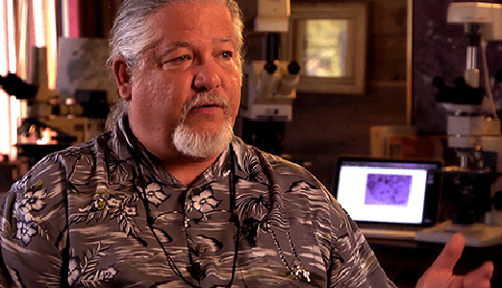
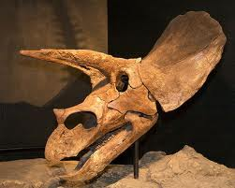
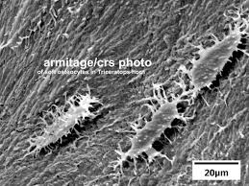
Dr. Mark Armitage
Notes:
"Mark Armitage, who specializes in microscopic evidence for a young earth, unexpectedly stumbled upon soft tissue in a triceratops fossil and wrote about his discovery for a scientific journal. Two weeks later, he was out of a job. Armitage filed suit against the university's board of trustees… citing wrongful termination and religious discrimination."

Slide 19
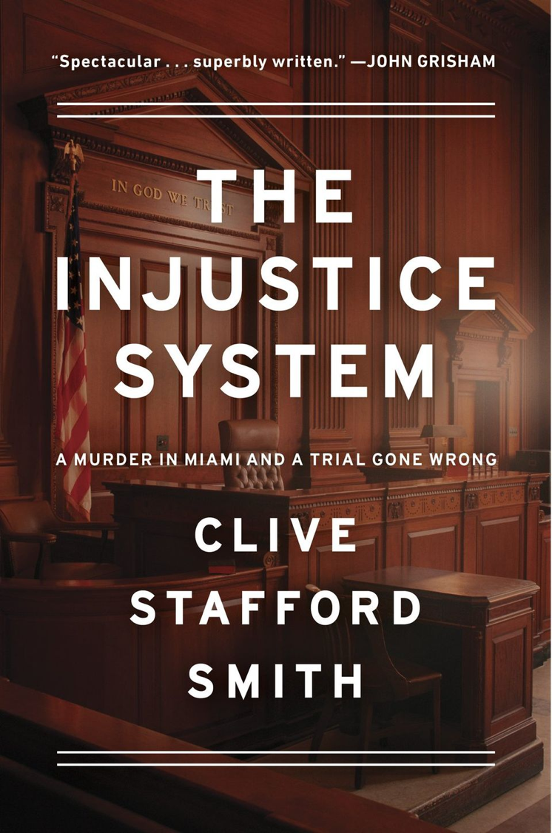

The Injustice System
Notes:
"Terminating an employee because of their religious views is completely inappropriate and illegal," Brad Dacus, president of Pacific Justice Institute, said in a press release. "But doing so in an attempt to silence scientific speech at a public university is even more alarming. This should be a wakeup call and warning to the entire world of academia."

Slide 20
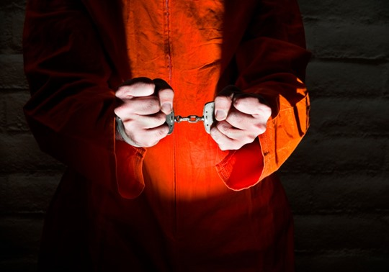
How should we respond to injustice?

Slide 21
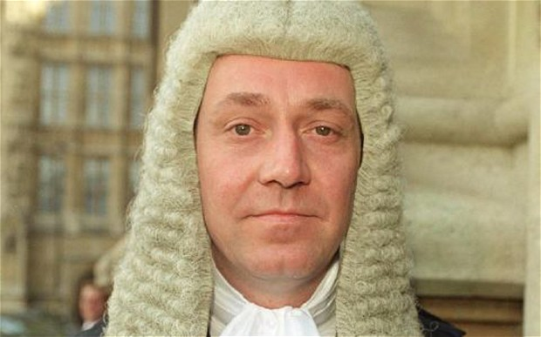
Realize that you will account to God (3:17).
Injustice
You
Notes:
So how does God want us to handle these injustices? We may not be able to change the system, but we can change us! The next verse says to…
/// Realize that you will account to God (3:17)

Slide 22
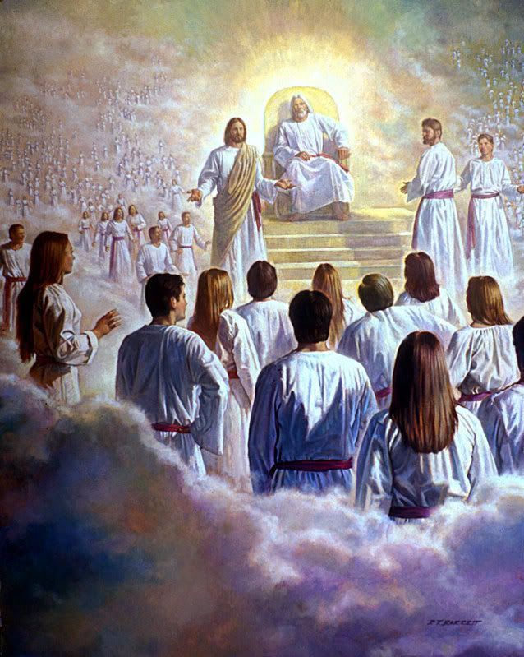
"Then I saw a great white throne…"
(Rev. 20:11)
438

Slide 23
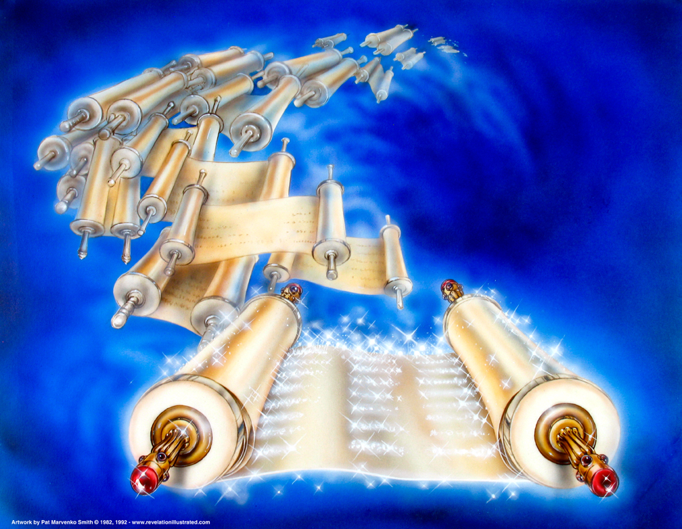
The Books
(Rev. 20:12)
Used with permission

Slide 24
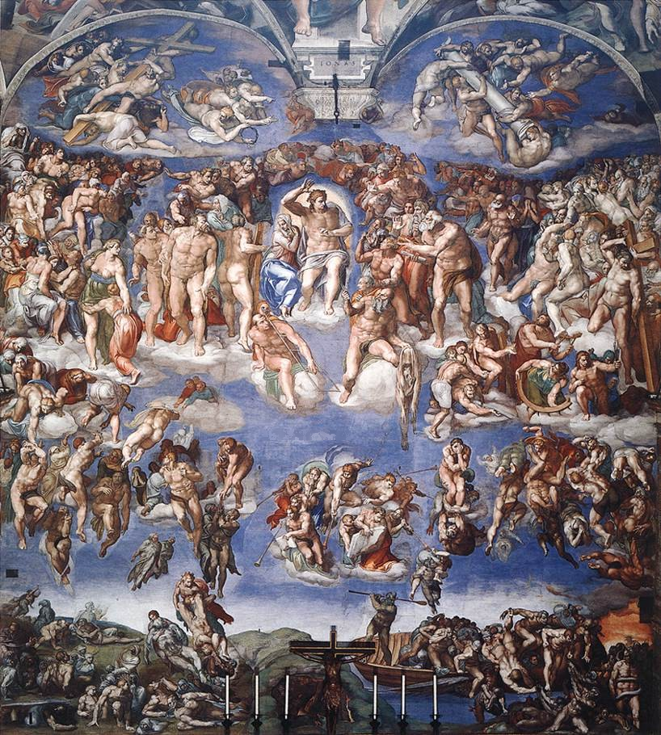
The Final Judgment
Is there one general judgment as depicted by Michelangelo?
Sistine Chapel, 1541

Slide 25

Yet Scripture prophesies seven more future judgments…
Sound strange?

Slide 26
Resurrections & Judgments
R = 4 Resurrected Groups
J = 7 Judged Groups
Rapture
2nd Advent
R
2R
R
Great
White
Throne
J
4J
2J
Church Age
Tribulation
Millennium
Battle of
Armageddon
Battle of
Gog and Magog

Slide 27

The Judgment Seat of Christ
Believers Rewarded by Christ (2 Cor. 5:10)
At the Rapture
(1 Thess. 4:17)
Reward or loss of rewards (not salvation)

Slide 28

We all will appear before God—not just the perpetrators of injustice!

Slide 29
I. Realize that you will account to God (3:16-17).
Injustice
You

Slide 30
Issues & Responses
Injustice
You
Death
Enjoy

Slide 31
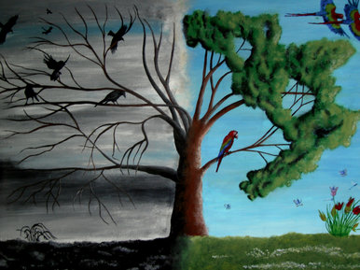
II. Enjoy life now (3:18-22)!
Death
Enjoy

Slide 32
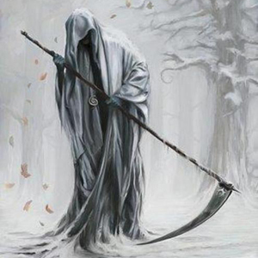
It may seem unjust that we are mortal like animals (3:18-21).

Slide 33

"Man's fate is like that of the animals; the same fate awaits them both: As one dies, so dies the other. All have the same breath; man has no advantage over the animal. Everything is meaningless"
(3:19 NIV)
"Everything" should be translated "both" (as in 2:14; 7:18; cf. BKC)
Both man and animals are transitory (not meaningless)

Slide 34

Hebel literally means
"a breath, wind, or vapor"
(Prov. 21:6; Isa. 57:13).
Key Word of Ecclesiastes

Slide 35

Meaning of Hebel
lbh
"vanity" (KJV, ESV, NAU), "meaningless" (NIV, NLT), "futile" (NET, TLB, BKC)
"fleeting"
Ecclesiastes

Slide 36
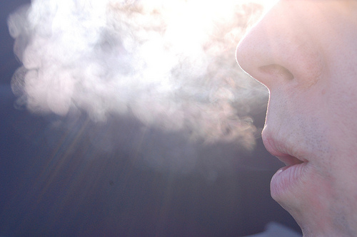
A Very Literal Translation
Metaphor:
what doesn't last ("what is without real substance, value, permanence, significance, or meaning" BKC, 1:976)

Slide 37
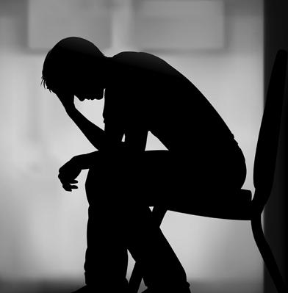
Many people don't want to even think about death.

Slide 38
"Four" in Chinese
诛
四
"Death" in Chinese

Slide 39
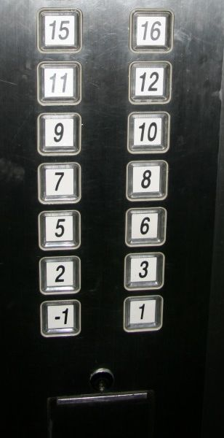
Where's level 4?

Slide 40
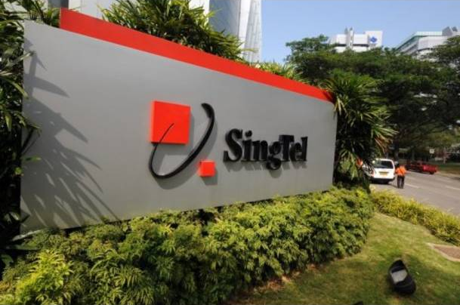
Getting a Phone Number…
Notes:
A Norwegian friend called Singapore Telecom some years back and requested an easy-to-remember telephone number. The customer service lady said, "Do you mind a number with a lot of "4s"? Ola responded, "Why do you ask?" "Because it's hard to give out these numbers as they sound like death," she responded. "No problem," Ola said. "Great!" was the response. "Your number is 6447-4464."

Slide 41
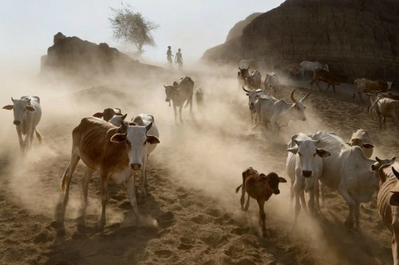
All return to dust
Notes:
Both people and animals came from and return to the dust (3:20).
This isn't a dismal statement from a cynic.
It is a reality that we are as mortal as animals.

Slide 42
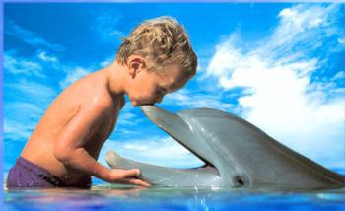
Our advantage over animals can't be shown or observed as they die (3:21).

Slide 43
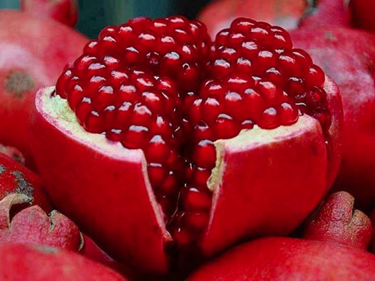
Realizing that we all will die should cause us to enjoy life now (3:22).

Slide 44
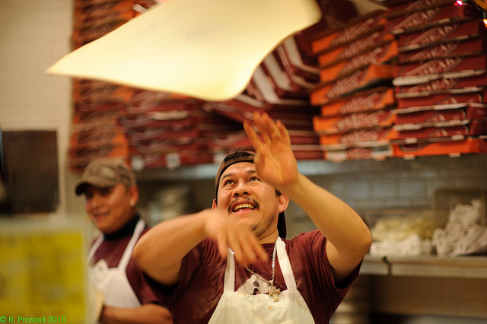
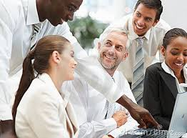
"So I saw that there is nothing better for people than to be happy in their work. That is why we are here! No one will bring us back from death to enjoy life after we die" (3:22 NLT).

Slide 45
"So I saw that there is nothing better for people than to be happy in their work. That is why we are here! No one will bring us back from death to enjoy life after we die" (3:22 NLT).
"I have seen that nothing is better than that man should be happy in his activities, for that is his lot. For who will bring him to see what will occur after him?" (3:22 NAU).

Slide 46

"This is man's lot (a word that means lit., 'portion, share, or allotment'…)… people are ignorant of God's plan and cannot know what the future, including life after death, holds for them. He summarized this point in the rhetorical question, Who can bring him to see what will happen after him?" (Donald Glenn, in BKC, 1:986).

Slide 47
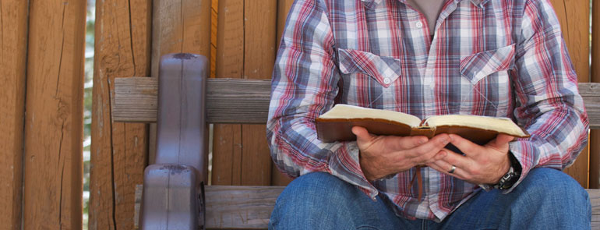
We don't know many details of the afterlife (3:22b).

Slide 48
What should you do when life is unfair?

Slide 49

Account to God and enjoy life!
Main Idea
What should you do when life is unfair?

Slide 50
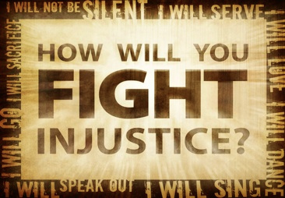
How will you fight injustice?

Slide 51
Responses to Injustice
Observer
Initiator
Victim

Slide 52
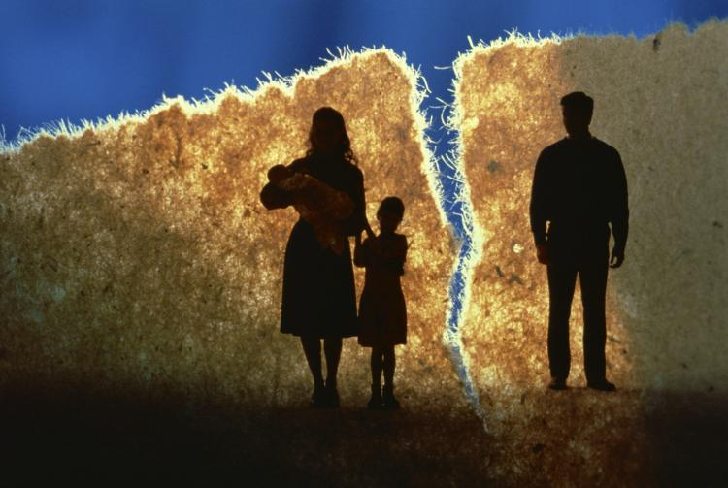
How do you observe injustice?
Observer
Notes:
Stand up for the victim of injustice you already see.
Support an orphan child through World Vision.
Get involved with Lakeside Family Services.

Slide 53
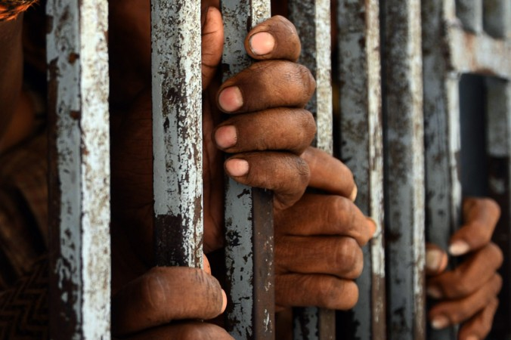
How do you initiate injustice?
Initiator
Notes:
Change procedures at work to pay employees fairly.
Spend more time with your wife/husband/family.

Slide 54
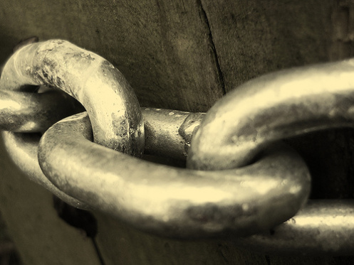
How are you the victim of injustice?
Victim
Notes:
Identify your area of struggle: What is your unjust disadvantage?
Exchange feeling sorrow for yourself for positive action: When do you plan to replace passive self-pity with active courage?
Trust God to minister to others through your disadvantage: Have you considered the impact your distinctive message would have on the world around you?

Slide 55
Black

Slide 56


OT Preaching link at BibleStudyDownloads.org
Get this presentation and script for free!

